Slide 1

Keeping Fit
By Abdelrahman

Slide 2

Keeping fit is important for our health and well-being. It means that our body is able to function well and resist diseases. Here is a simple way to understand it: We want to be healthy and happy. To be healthy and happy, we need our body to work well and not get sick. Keeping fit is what we do to make our body work well and not get sick.

Slide 3
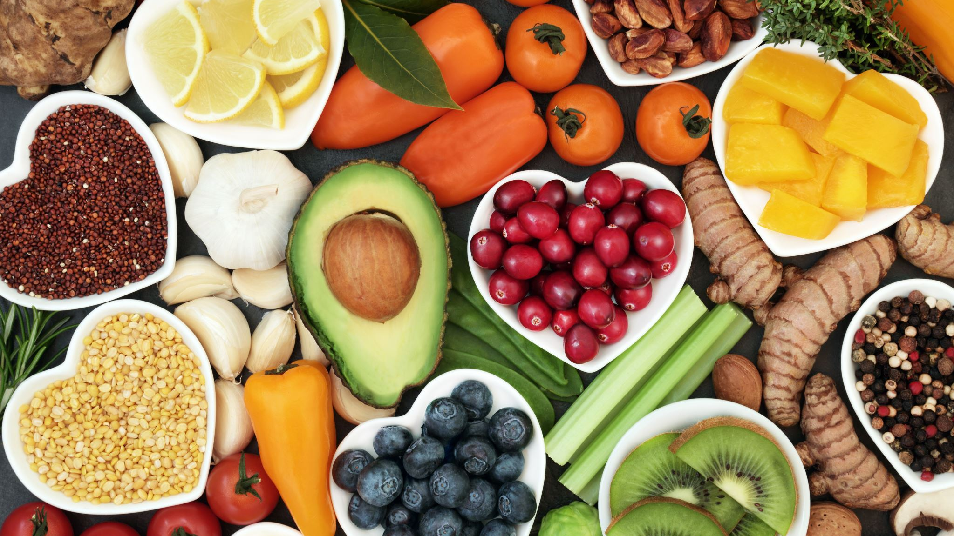
Eating good food is good for our body. Good food has many different things that we need to grow and live. Good food has fruits, vegetables, grains, meat, and fat. Some examples of good food are apples, carrots, rice, chicken, and butter.

Slide 4

Drinking water is good for our body. Water can keep our body wet and clean. Water also helps us with our body heat and food. We need to drink enough water every day.

Slide 5
Moving our body is good for us. Some things we can do to move our body are walk, run, bike, swim, dance, play, or yoga.

Slide 6

Sleeping is important for our body and mind to heal and get ready. Sleep can change how our body defense, memory, learning, mood, and mind health work. How much we need to sleep changes with our age, but usually adults need about 7 to 9 hours of sleep every night.

Slide 7

Bad things like smoking, alcohol, and drugs can hurt our body and cause many diseases and death.

Slide 8

Keeping fit is good for our health and happiness, so we should eat, drink, move, sleep, and avoid bad things well.

